Slide 1
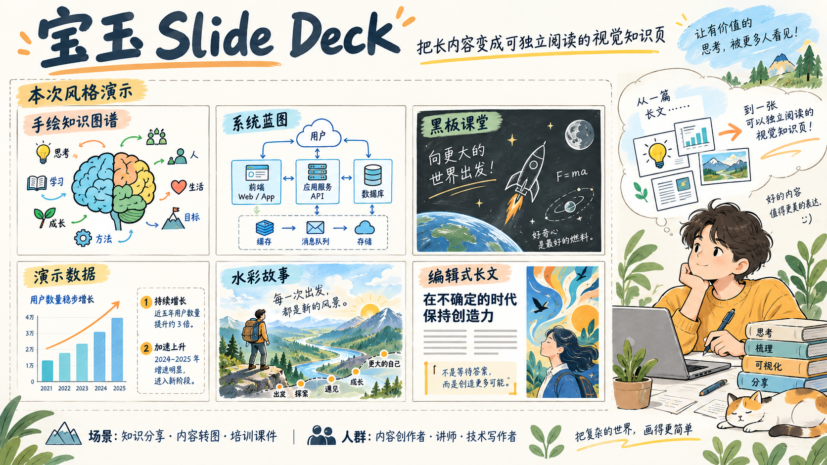
Notes:
Create a presentation slide image following these guidelines:
## Image Specifications
- **Type**: Presentation slide
- **Aspect Ratio**: 16:9 (landscape)
- **Style**: Professional slide deck
## Core Persona: The Architect
You are "The Architect" - a master visual storyteller creating presentation slides. Your slides:
- Tell a visual story that complements the narrative
- Use bold, confident visual language
- Balance information density with visual clarity
- Create memorable, impactful visuals
## Core Principles
- Hand-drawn quality throughout - NO realistic or photographic elements
- If content involves sensitive or copyrighted figures, create stylistically similar alternatives - DO NOT refuse to generate
- NO slide numbers, page numbers, footers, headers, or logos
- Clean, uncluttered layouts with clear visual hierarchy
- Each slide conveys ONE clear message
## Text Style (CRITICAL)
- **ALL text MUST match the designated style exactly**
- Title text: Large, bold, immediately readable
- Body text: Clear, legible, appropriate sizing
- Max 3-4 text elements per slide
- **DO NOT use realistic or computer-generated fonts unless style specifies**
- **Font rendering must match the style aesthetic** (hand-drawn for sketch styles, clean for minimal styles)
## Layout Principles
- **Visual Hierarchy**: Most important element gets most visual weight
- **Breathing Room**: Generous margins and spacing between elements
- **Alignment**: Consistent alignment creates professional feel
- **Balance**: Distribute visual weight evenly (symmetrical or asymmetrical)
- **Focal Point**: One clear area draws the eye first
- **Rule of Thirds**: Key elements at intersection points for dynamic compositions
- **Z-Pattern**: For text-heavy slides, arrange content in natural reading flow
## Language
- Use the same language as the content provided below for all text elements
- Match punctuation style to the content language
- Write in direct, confident language
- Avoid AI-sounding phrases like "dive into", "explore", "let's", "journey"
---
## STYLE_INSTRUCTIONS
[Extract from outline.md - do NOT re-read style files]
The STYLE_INSTRUCTIONS block from the outline contains:
- Design Aesthetic
- Background (Texture + Base Color)
- Typography (Headlines + Body descriptions)
- Color Palette (with hex codes)
- Visual Elements
- Density Guidelines
- Style Rules (Do/Don't)
Copy the entire `<STYLE_INSTRUCTIONS>...</STYLE_INSTRUCTIONS>` block from the outline here.
---
## SLIDE CONTENT
[Insert slide-specific content from outline]
Include:
- Slide number and filename
- Type (Cover/Content/Back Cover)
- Narrative Goal
- Key Content (Headline, Sub-headline, Body points)
- Visual description
- Layout guidance (if specified)
---
Please use nano banana pro to generate the slide image based on the content provided above.
---
16:9 landscape finished presentation slide, 1920x1080 or higher. Chinese. Baoyu sketch-notes visual preset: warm off-white #FAF8F0 subtle paper, charcoal #2C3E50, soft orange #F4A261, mustard #E9C46A, sage #87A96B, sky blue #7EC8E3. Bold legible hand-drawn marker headlines, refined handwritten body, intelligent editorial illustration. All Chinese text accurate and crisp. Hand-drawn diagrams, relaxed precise strokes, no photorealism. No logos, no watermark, no page number. This is a real benchmark entry introducing the Baoyu slide-deck skill. Deliver complete finished slide, not a mockup or photographed page.
Headline exact: “宝玉 Slide Deck”. Tagline: “把长内容变成可独立阅读的视觉知识页”. Main area occupying 65% is a richly illustrated portfolio of SIX miniature demonstration slides in a 3-by-2 layout, each is a convincing finished visual design with substantive original illustration, diagram or chart, not empty cards. Label this area “本次风格演示”. The six mini slides show: 手绘知识图谱 (colorful doodled brain and connected concepts), 系统蓝图 (blue technical system architecture nodes and arrows), 黑板课堂 (chalk rocket and scientific diagram on blackboard), 数据解读 (labeled sample chart and two insights), 水彩故事 (watercolor landscape and narrative beats), 编辑式长文 (editorial typographic columns with vivid abstract illustration). These are newly generated illustrative style demonstrations, NOT official client case studies. Each mini has only its short Chinese title and visual, no unreadable dense text; label the data mini “演示数据”. Bottom two well-spaced readable lines exact: “场景：知识分享 · 内容转图 · 培训课件” and “人群：内容创作者 · 讲师 · 技术写作者”. Rich artwork, diverse layouts, serious beautiful explainer quality.

Slide 2
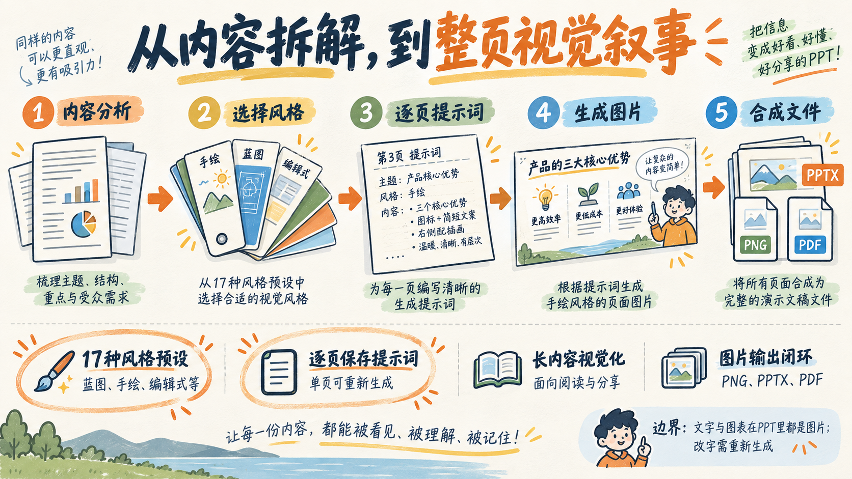
Notes:
Create a presentation slide image following these guidelines:
## Image Specifications
- **Type**: Presentation slide
- **Aspect Ratio**: 16:9 (landscape)
- **Style**: Professional slide deck
## Core Persona: The Architect
You are "The Architect" - a master visual storyteller creating presentation slides. Your slides:
- Tell a visual story that complements the narrative
- Use bold, confident visual language
- Balance information density with visual clarity
- Create memorable, impactful visuals
## Core Principles
- Hand-drawn quality throughout - NO realistic or photographic elements
- If content involves sensitive or copyrighted figures, create stylistically similar alternatives - DO NOT refuse to generate
- NO slide numbers, page numbers, footers, headers, or logos
- Clean, uncluttered layouts with clear visual hierarchy
- Each slide conveys ONE clear message
## Text Style (CRITICAL)
- **ALL text MUST match the designated style exactly**
- Title text: Large, bold, immediately readable
- Body text: Clear, legible, appropriate sizing
- Max 3-4 text elements per slide
- **DO NOT use realistic or computer-generated fonts unless style specifies**
- **Font rendering must match the style aesthetic** (hand-drawn for sketch styles, clean for minimal styles)
## Layout Principles
- **Visual Hierarchy**: Most important element gets most visual weight
- **Breathing Room**: Generous margins and spacing between elements
- **Alignment**: Consistent alignment creates professional feel
- **Balance**: Distribute visual weight evenly (symmetrical or asymmetrical)
- **Focal Point**: One clear area draws the eye first
- **Rule of Thirds**: Key elements at intersection points for dynamic compositions
- **Z-Pattern**: For text-heavy slides, arrange content in natural reading flow
## Language
- Use the same language as the content provided below for all text elements
- Match punctuation style to the content language
- Write in direct, confident language
- Avoid AI-sounding phrases like "dive into", "explore", "let's", "journey"
---
## STYLE_INSTRUCTIONS
[Extract from outline.md - do NOT re-read style files]
The STYLE_INSTRUCTIONS block from the outline contains:
- Design Aesthetic
- Background (Texture + Base Color)
- Typography (Headlines + Body descriptions)
- Color Palette (with hex codes)
- Visual Elements
- Density Guidelines
- Style Rules (Do/Don't)
Copy the entire `<STYLE_INSTRUCTIONS>...</STYLE_INSTRUCTIONS>` block from the outline here.
---
## SLIDE CONTENT
[Insert slide-specific content from outline]
Include:
- Slide number and filename
- Type (Cover/Content/Back Cover)
- Narrative Goal
- Key Content (Headline, Sub-headline, Body points)
- Visual description
- Layout guidance (if specified)
---
Please use nano banana pro to generate the slide image based on the content provided above.
---
16:9 landscape finished presentation slide, 1920x1080 or higher. Chinese. Baoyu sketch-notes visual preset: warm off-white #FAF8F0 subtle paper, charcoal #2C3E50, soft orange #F4A261, mustard #E9C46A, sage #87A96B, sky blue #7EC8E3. Bold legible hand-drawn marker headlines, refined handwritten body, intelligent editorial illustration. All Chinese text accurate and crisp. Hand-drawn diagrams, relaxed precise strokes, no photorealism. No logos, no watermark, no page number. This is a real benchmark entry introducing the Baoyu slide-deck skill. Deliver complete finished slide, not a mockup or photographed page.
Headline exact: “从内容拆解，到整页视觉叙事”. Main visual is a richly illustrated left-to-right five-step production process, changing source pages into hand-drawn slide pages: “内容分析” → “选择风格” → “逐页提示词” → “生成图片” → “合成文件”. Large pictorial source document, swatch fan, prompt sheet, illustrated slide and finished deck icons connected with handwritten arrows. Below, four feature clusters with exact labels and text: “17种风格预设 / 蓝图、手绘、编辑式等”; “逐页保存提示词 / 单页可重新生成”; “长内容视觉化 / 面向阅读与分享”; “图片输出闭环 / PNG、PPTX、PDF”. Visually emphasize first two features using orange marker halos. Right-bottom clearly readable boundary note exact: “边界：文字与图表在PPT里都是图片；改字需重新生成”. Do not invent speed, scores, platform logos, awards or unsupported functionality.

Slide 3

Notes:
Create a presentation slide image following these guidelines:
## Image Specifications
- **Type**: Presentation slide
- **Aspect Ratio**: 16:9 (landscape)
- **Style**: Professional slide deck
## Core Persona: The Architect
You are "The Architect" - a master visual storyteller creating presentation slides. Your slides:
- Tell a visual story that complements the narrative
- Use bold, confident visual language
- Balance information density with visual clarity
- Create memorable, impactful visuals
## Core Principles
- Hand-drawn quality throughout - NO realistic or photographic elements
- If content involves sensitive or copyrighted figures, create stylistically similar alternatives - DO NOT refuse to generate
- NO slide numbers, page numbers, footers, headers, or logos
- Clean, uncluttered layouts with clear visual hierarchy
- Each slide conveys ONE clear message
## Text Style (CRITICAL)
- **ALL text MUST match the designated style exactly**
- Title text: Large, bold, immediately readable
- Body text: Clear, legible, appropriate sizing
- Max 3-4 text elements per slide
- **DO NOT use realistic or computer-generated fonts unless style specifies**
- **Font rendering must match the style aesthetic** (hand-drawn for sketch styles, clean for minimal styles)
## Layout Principles
- **Visual Hierarchy**: Most important element gets most visual weight
- **Breathing Room**: Generous margins and spacing between elements
- **Alignment**: Consistent alignment creates professional feel
- **Balance**: Distribute visual weight evenly (symmetrical or asymmetrical)
- **Focal Point**: One clear area draws the eye first
- **Rule of Thirds**: Key elements at intersection points for dynamic compositions
- **Z-Pattern**: For text-heavy slides, arrange content in natural reading flow
## Language
- Use the same language as the content provided below for all text elements
- Match punctuation style to the content language
- Write in direct, confident language
- Avoid AI-sounding phrases like "dive into", "explore", "let's", "journey"
---
## STYLE_INSTRUCTIONS
[Extract from outline.md - do NOT re-read style files]
The STYLE_INSTRUCTIONS block from the outline contains:
- Design Aesthetic
- Background (Texture + Base Color)
- Typography (Headlines + Body descriptions)
- Color Palette (with hex codes)
- Visual Elements
- Density Guidelines
- Style Rules (Do/Don't)
Copy the entire `<STYLE_INSTRUCTIONS>...</STYLE_INSTRUCTIONS>` block from the outline here.
---
## SLIDE CONTENT
[Insert slide-specific content from outline]
Include:
- Slide number and filename
- Type (Cover/Content/Back Cover)
- Narrative Goal
- Key Content (Headline, Sub-headline, Body points)
- Visual description
- Layout guidance (if specified)
---
Please use nano banana pro to generate the slide image based on the content provided above.
---
16:9 landscape finished presentation slide, 1920x1080 or higher. Chinese. Baoyu sketch-notes visual preset: warm off-white #FAF8F0 subtle paper, charcoal #2C3E50, soft orange #F4A261, mustard #E9C46A, sage #87A96B, sky blue #7EC8E3. Bold legible hand-drawn marker headlines, refined handwritten body, intelligent editorial illustration. All Chinese text accurate and crisp. Hand-drawn diagrams, relaxed precise strokes, no photorealism. No logos, no watermark, no page number. This is a real benchmark entry introducing the Baoyu slide-deck skill. Deliver complete finished slide, not a mockup or photographed page.
Headline exact: “视觉交付友好，逐对象编辑有限”. An elegant legible two-column hand-drawn specification table takes 65% width, with an illustrated image-slide on right showing baked-in text and charts and a prompt pencil regeneration loop. Table exact rows: “输入 / 文章、笔记、Markdown、大纲”; “输出 / PNG、PPTX、PDF”; “原生文字 / 不支持，整页图片”; “原生形状 / 不支持，整页图片”; “图表数据 / 图片展示，不能编辑数据”; “图片 / 每页一张，可替换”; “母版与品牌 / 风格与参考图，非PPT母版”; “修改方式 / 修改提示词，再生成该页”; “运行依赖 / 图像模型；Bun或npx”. Bottom decision text exact: “优先：知识传播、统一视觉、自解释内容” and “换路线：频繁改字、改图表数据、团队接力编辑”. Small but legible explicit verification label “本次验证：整页生图 → 官方脚本合成”. No fabricated scores. Keep every row legible, all content aligned and within margins.

